Slide 1
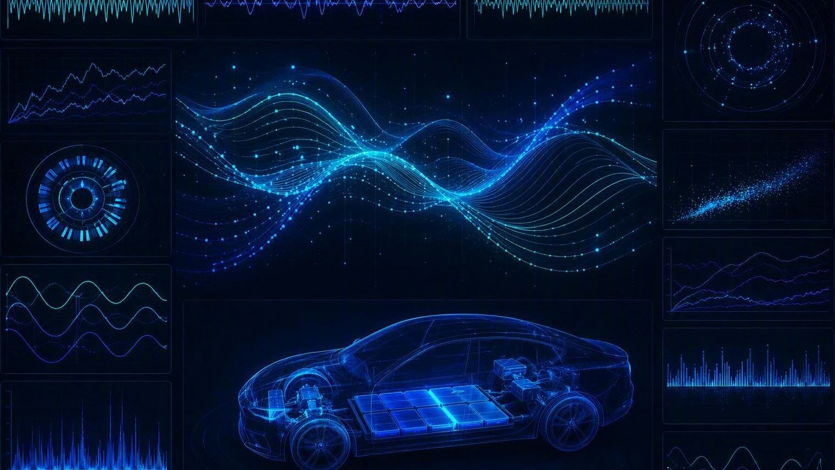
VEHICLE DATA ANALYTICS
Machine Learning for
Vehicle Signal Analytics
Presented by
Mulubrhan A. Nerea I Summer Worker
July 2026
VOLVO

Slide 2








THE MOTIVATION
Why Machine Learning?
Every day we collect thousands of vehicle signals.
Torque
Motor speed
How can we automatically discover useful information from these signals
?
Battery voltage
Temperature
Machine Learning is one answer.
Brake pressure
Accelerator pedal
Steering angle
Manual limit: Time consuming, too slow to scale.
ML : finds patterns automatically, Predication, Early Fault detection.
VOLVO · Machine Learning for Vehicle Signal Analytics · July 2026
02

Slide 3







WHERE WE ARE TODAY
The Current Workflow
›
›
›
›
›
›
Vehicle
Sensors
Signal Recording
MDF / MF4 / MSG
Python
Plots
Manual analysis
What happens when we have…
500
50 TB
Millions
vehicles
of measurements
of signals
Manual analysis becomes impossible.
ML helps engineers work faster — it doesn't replace them.
VOLVO · Machine Learning for Vehicle Signal Analytics · July 2026
03

Slide 4
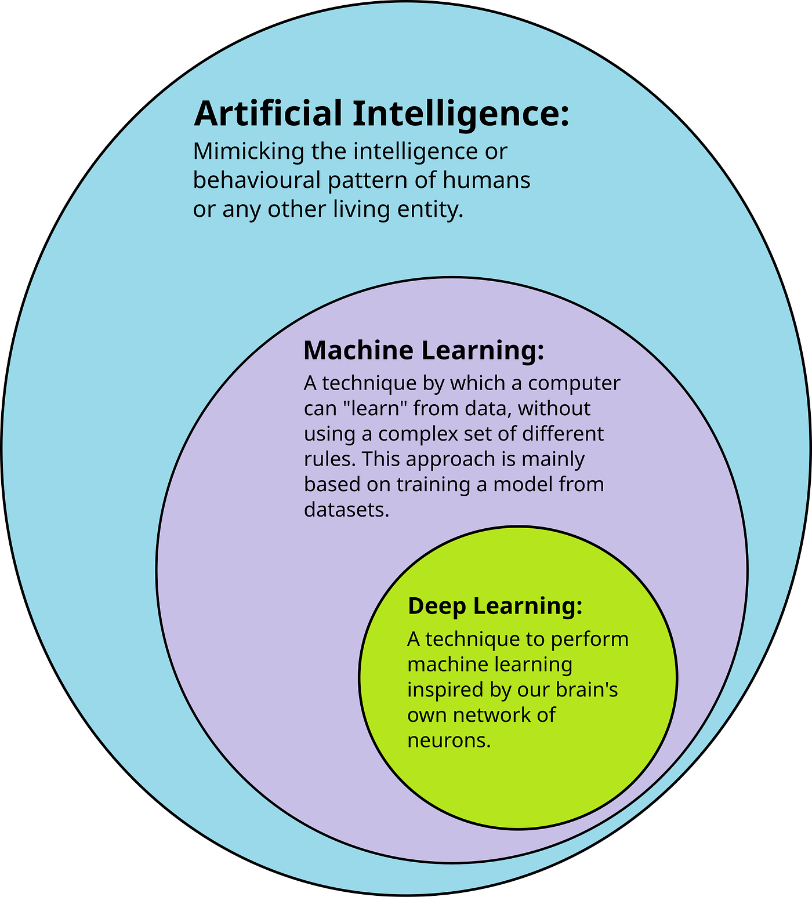



THE CORE IDEA
What is Machine Learning?
Algorithms that learn patterns from historical data to make predictions or decisions —
without being explicitly programmed.
›
›
Historical
Data/Signals
Machine
Learning
the model keeps learning
Prediction
Learns from Feedback
Improves over time
Prediction
Decision or action
Find Patterns
Train the model
Analyze Data
Clean & explore
Input Data
Historical / old data
VOLVO · Machine Learning for Vehicle Signal Analytics · July 2026
04

Slide 5



THREE FAMILIES
Types of Machine Learning
TYPE
WHAT IT MEANS
EXAMPLE
Supervised
Trained on labeled data where the correct answer is already known.
Has Labels
Predict overtorque
Cat
Dog
Unsupervised
Finds hidden patterns and structure in data that has no labels.
No Labels
Detect unusual driving
Reinforcement
Learns by trial and error, guided by rewards and penalties.
Autonomous driving
Supervised learning
is the most common approach in vehicle analytics.
VOLVO · Machine Learning for Vehicle Signal Analytics · July 2026
05

Slide 6




END TO END
The Machine Learning Workflow
›
›
›
›
›
›
Vehicle
Data Collection/Measurement
Data Cleaning
Feature Engineering
Model Training
Evaluation
Deployment
Collect signal data from the vehicle/Test System.
Remove noise, gaps, and outliers.
Transform raw to meaningful feature
Build variables that capture behavior.
Fit algorithms to learn the patterns.
Check accuracy on held-out data.
Ship the model for offline/Realtime predictions.
Most projects fail because of poor data quality, not poor algorithms.
Cleaning and feature engineering are where the real work happens.
VOLVO · Machine Learning for Vehicle Signal Analytics · July 2026
06

Slide 7





THE HIDDEN REALITY
Data Cleaning
Feature Engineering
Transform raw data into insight of model
Instead of raw Torque, Calculate :
70–80%
Mean torque
Noise
Maximum torque
Missing values
of a data scientist's time is spent preparing data
Torque ripple
Standard deviation
Synchronization
Duplicate signals
Peak speed
Acceleration
Clean signals in, reliable models out
this is where engineers add the most value.
Features often matter more, A simple model with strong features usually beats a complex model fed raw signals.
VOLVO · Machine Learning for Vehicle Signal Analytics · July 2026
07

Slide 8




THE TOOLBOX
Common ML Algorithms
Linear Regression
Decision Trees
Random Forest
Predict Continues Values, Simple
Transparent rule-based splits
Robust classification/ensemble of trees
XGBoost
Support Vector Machine
Neural Networks
High-accuracy gradient boosting/tabular data
Strong decision boundaries
Complex, non-linear patterns
Different problems require different models.
VOLVO · Machine Learning for Vehicle Signal Analytics · July 2026
09

Slide 9
REAL EXAMPLES
Example: Over-torque & Anomaly Detection
Over-torque model
Anomaly detection
Predict overtorque before it happens
ML flags these automatically:
Torque · Speed · Temperature · Pedal
Unexpected torque spikes
↓
Sensor failures
Signal Files → Python → Features → Random Forest
Abnormal vibration
↓
Electrical faults
Will overtorque occur?
Unexpected temperature increase
YES
NO
A natural fit: engineers already look for these — ML does it continuously.
VOLVO · Machine Learning for Vehicle Signal Analytics · July 2026
10

Slide 10




DID THE MODEL WORK?
Evaluation
Evaluate using data the model has never seen before
Accuracy
(TP + TN) / Total
Percentage of correct predictions.,
97
Precision
TP / (TP + FP)
Correct positive calls, how often is it correct !
79.2
Recall
TP / (TP + FN)
Real faults caught, how many faults
95
F1-score
2 · P · R / (P + R)
Balances precision and recall
86.4
Confusion Matrix
TP FP / FN TN
Predicted vs. actual
Actual /120 | Predict | Result
over torque | over torque | 95
normal | Over torque | 25
Over torque | Normal | 5
In fault detection, not all errors are equal.
Missing a real fault can be far more costly than raising a false alarm
— so recall often matters more than raw accuracy.
VOLVO · Machine Learning for Vehicle Signal Analytics · July 2026
11

Slide 11





PUTTING IT TO WORK
Some Use Cases
Predict overtorque
Battery health prediction
Motor fault detection
Remaining useful life
Predictive maintenance
Energy consumption optimization
Driver behavior analysis
Vehicle diagnostics
VOLVO · Machine Learning for Vehicle Signal Analytics · July 2026
12

Slide 12





WHAT MAKES IT HARD
Challenges
High-frequency signals
Large datasets
Noise
Missing values
Class imbalance
Labeling faults
Model interpretability
Real-time inference
These are exactly the issues engineers meet every day.
VOLVO · Machine Learning for Vehicle Signal Analytics · July 2026
13

Slide 13









THE PRACTITIONER'S STACK
Tools
Python
Core programming language
NumPy
Numerical array computing
Pandas
Data analysis toolkit
Scikit-learn
Classic ML algorithms
TensorFlow
Deep learning framework
PyTorch
Deep learning framework
Keras
Neural network API
Jupyter Notebook
Interactive notebooks
Git
Version control
VOLVO · Machine Learning for Vehicle Signal Analytics · July 2026
14

Slide 14
IN SUMMARY
Key Takeaways
Machine Learning…
learns patterns
scales to massive datasets
supports engineers
predicts failures
automates analysis
enables smarter vehicles
VOLVO · Machine Learning for Vehicle Signal Analytics · July 2026
15

Slide 15
Questions?
Thank you!
VOLVO · Machine Learning for Vehicle Signal Analytics · Mulubrhan A. Nerea · July 2026

